Slide 1
IEEE
The world's largest technical professional organization for the advancement of technology

Slide 2
Overview
IEEE, pronounced "Eye-triple-E," stands for the Institute of Electrical and Electronics Engineers.
IEEE, an association dedicated to advancing innovation and technological excellence for the benefit of humanity.
It is designed to serve professionals involved in all aspects of the electrical, electronic, and computing fields. Furthermore, allied professionals, computer scientists, software developers, information technology professionals, physicists, medical doctors..etc.
IEEE's roots go back to 1884.

Slide 3
history
Foundation of the AIEE
the American Institute of Electrical Engineers
In the spring of 1884, a small group of individuals in the electrical professions met in New York, USA.
They formed a new organization to support professionals in their nascent field and to aid them in their efforts to apply innovation for the betterment of humanity.

Slide 4
Foundation of the IRE
new industry arose, beginning with Guglielmo Marconi’s wireless telegraphy experiments in 1895-1896.
And electrical amplification possibilities inherent in the vacuum tubes that evolved from John Fleming’s diode and Lee de Forest’s triode.
With the new industry came a new society in 1912, the Institute of Radio Engineers.

Slide 5
IEEE
On 1 January 1963, the AIEE and the IRE merged to form the Institute of Electrical and Electronics Engineers, or IEEE.
By the early 21st century, IEEE served its members and their interests with 39 Societies; 130 journals, transactions, and magazines; more than 300 conferences annually; and 900 active standards.
Since then IEEE’s fields of interest expanded well beyond electrical and electronics engineering and computing into areas such as micro- and nanotechnologies, ultrasonics, bioengineering, robotics, electronic materials, and many others.

Slide 6
IEEE Organization
Grouped into geographic areas reflecting where we
live and work.
10 Geographic Regions
  324 Sections within Regions
  2,600 Student Branches

Slide 7
IEEE
Societies
IEEE has 39 technical Societies that provide benefits to members within specialized fields of interest. Society memberships enable you stay current within your chosen technology profession, keep in touch with your peers, and invest in your career.
Aerospace and Electronic Systems Society
Antennas and Propagation Society
Broadcast Technology Society
Circuits and Systems Society
Communications Society
Computational Intelligence Society
Control Systems Society
Dielectrics and Electrical Insulation Society
Education Society
Electromagnetic Compatibility Society
Electron Devices Society
….etc.

Slide 8
IEEE
Geographic Unit Resources
IEEE local geographic organizational units - regions, sections,
chapters, student branches, and affinity groups - provide unique
opportunities for members to attend technical presentations,
create strong peer-to-peer connections, and participate in
leadership opportunities that can make a positive distinction in IEEE
members' jobs and careers.

Slide 9
IEEE SA
Standards Association & working groups
IEEE Standards Association
(IEEE SA) working groups aim to set priorities and develop appropriate standards. IEEE SA working groups are open to everyone and participants need not be IEEE SA members.
Enhance Global Reach
IEEE SA cultivates collaboration and helps to mobilize people from diverse backgrounds and industry sectors in a unique borderless standardization paradigm to develop market relevant open standards and solutions that go beyond standards.
Get a Direct Connection to Industry
By participating in IEEE SA global standards development and related programs, you get connected to experts, resources and information—empowering you with advanced insights into market requirements, needs and trends for a competitive edge.

Slide 10
IEEE SA
Standards Association & working groups
Pave New Paths
Members of the growing IEEE SA community create new market spaces and enhance existing ones, and work to proactively improve how standards are developed, used and innovated upon to benefit end users in the marketplace and benefit humanity.
Contribute to the Building Blocks for a Sustainable Future
Global, open standards play a prominent role in our lives. They are the unseen force behind innovation, serving as building blocks for a better world. By being part of IEEE SA and its programs, you help make technology safer, interoperable and sustainable for the future.

Slide 11
IEEE SA
Topics
Aerospace Electronics
Antennas and Propagation
Batteries
Blockchain
Communications
Computer Technology
Consumer Electronics
Dictionary
Electromagnetic Compatibility
Green and Clean Technology
Healthcare IT
Industry Applications
Instrumentation and Measurement
Nanotechnology
National Electrical Safety Code (NESC)
Nuclear Power
Power and Energy
Smart Grid
Software and Systems Engineering
Transportation
Wired and Wireless Communications

Slide 12
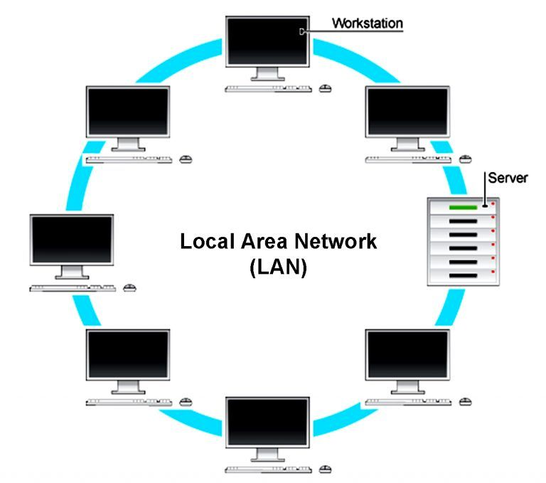
IEEE Standards
IEEE is best known for developing standards for the computer and electronics industry. In particular, the IEEE 802 standards for local-area networks (LANs) are widely followed.

Slide 13
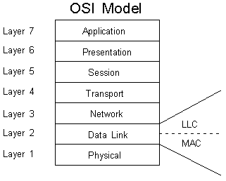
IEEE 802
IEEE 802 refers to a family of IEEE standards dealing with local area networks and metropolitan area network.
IEEE 802 splits the OSI Data Link Layer into two sub-layers:
  LLC(logical link control) sub layer
  MAC(media access control) sub layer

Slide 14
IEEE 802 Standards
IEEE 802.1 (networking) and Network Management
IEEE 802.2 Logical link control (upper part of data link layer)
IEEE 802.3 Ethernet (CSMA/CD)
IEEE 802.4 Token bus (disbanded)
IEEE 802.5 Defines the MAC layer for a Token Ring (inactive)
IEEE 802.6 Metropolitan Area Networks (disbanded)
IEEE 802.7 Broadband LAN using Coaxial Cable (disbanded)
IEEE 802.8 Fiber Optic TAG (disbanded)
IEEE 802.9 Integrated Services LAN (disbanded)
IEEE 802.10 Interoperable LAN Security (disbanded)
IEEE 802.11 Wireless LAN & Mesh (Wi-Fi certification)
IEEE 802.12 demand priority (disbanded)

Slide 15
IEEE 802 Standards
IEEE 802.13 Not Used
IEEE 802.14 Cable modems (disbanded)
IEEE 802.15 Wireless PAN
IEEE 802.15.1 (Bluetooth certification)
IEEE 802.15.4 (ZigBee certification)
IEEE 802.16 Broadband Wireless Access (WiMAX certification)
IEEE 802.17 Resilient packet ring
IEEE 802.18 Radio Regulatory TAG
IEEE 802.19 Coexistence TAG
IEEE 802.20 Mobile Broadband Wireless Access
IEEE 802.21 Media Independent Handoff
IEEE 802.22 Wireless Regional Area Network

Slide 16
IEEE 802.1
The IEEE 802.1 Working Group is chartered to concern itself with and develop standards and recommended practices in the following areas:
802 LAN/MAN architecture
internetworking among 802 LANs
MANs and other wide area networks
802 Security
802 overall network management
protocol layers above the MAC & LLC layers.

Slide 17
IEEE 802.2 LLC
It describes the functions, features, protocol, and services of the logical link control (LLC) sublayer, which constitutes the top sublayer in the data link layer of the ISO 8802 Local Area Network Protocol.
The IEEE 802.2 sublayer adds some control information to the message created by the upper layer and passed to the LLC for transmission to another node on the same data link.

Slide 18
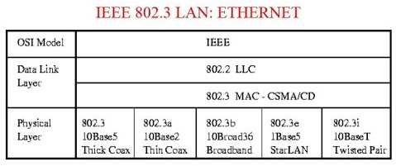
IEEE 802.3
Ethernet LAN operation is specified for selected speeds of operation from 1 Mb/s to 400 Gb/s using:
  common media access control (MAC)
  management information base (MIB)
The Carrier Sense Multiple Access with Collision Detection (CSMA/CD) MAC protocol specifies shared medium (half duplex) operation, as well as full duplex operation

Slide 19
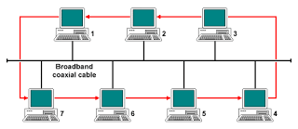
IEEE 802.4
Token bus is a network implementing the token ring protocol over a virtual ring on a coaxial cable.
A token is passed around the network nodes and only the node possessing the token may transmit.

Slide 20
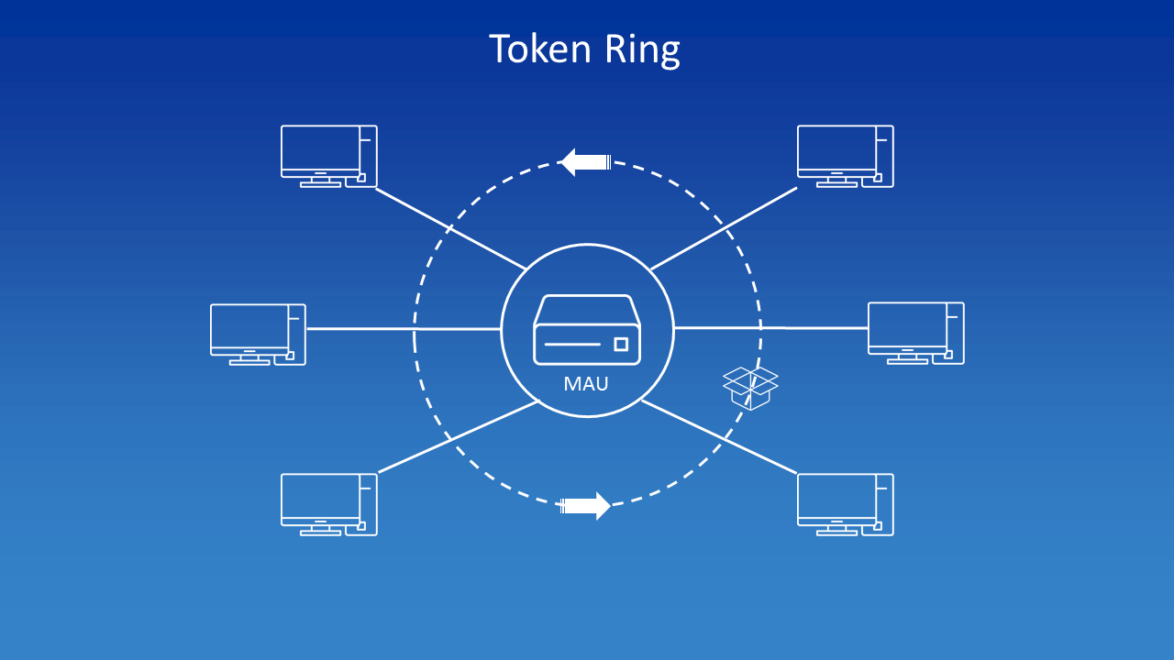
IEEE 802.5
Token Ring was introduced by IBM in 1984, and standardized in 1989 as IEEE 802.5.
It uses a special three-byte frame called a token that travels around a logical ring of workstations or servers.
This token passing is a channel access method providing fair access for all stations, and eliminating the collisions of contention-based access methods.

Slide 21
IEEE 802.11
IEEE 802.11 is part of the IEEE 802 set of LAN protocols, and specifies the set of media access control (MAC) and physical layer (PHY) protocols for implementing wireless local area network (WLAN) Wi-Fi.

Slide 22
IEEE 802.11
There are several specifications in the 802.11 family:
802.11 — applies to wireless LANs and provides 1 or 2 Mbps transmission in the 2.4 GHz band using either frequency hopping spread spectrum (FHSS) or direct sequence spread spectrum (DSSS).
802.11a — an extension to 802.11 that applies to wireless LANs and provides up to 54-Mbps in the 5GHz band. 802.11a uses an orthogonal frequency division multiplexing encoding scheme rather than FHSS or DSSS.
802.11b provides 11 Mbps transmission in the 2.4 GHz band. 802.11b uses only DSSS.

Slide 23
IEEE 802.11
802.11e — a wireless draft standard that defines the Quality of Service (QoS) support for LANs, and is an enhancement to the 802.11a and 802.11b wireless LAN (WLAN) specifications.
802.11e adds QoS features and multimedia support to the existing IEEE 802.11b and IEEE 802.11a wireless standards, while maintaining full backward compatibility with these standards.
802.11g used for transmission over short distances at up to 54-Mbps in the 2.4 GHz bands.
802.11n The real speed would be 100 Mbit/s (even 250 Mbit/s in PHY level), and so up to 4-5 times faster than 802.11g.
802.11ac The 802.11ac specification operates only in the 5 GHz frequency range and features support for wider channels (80MHz and 160MHz).

Slide 24
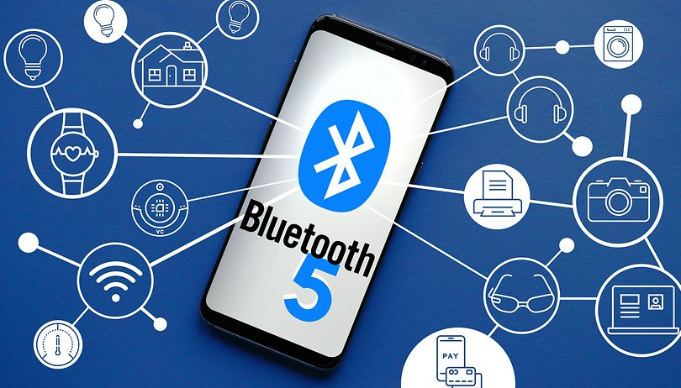
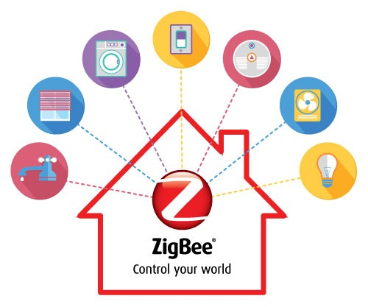
IEEE 802.15
Wireless Personal Area Network (WPAN) using low power and multiple modulation formats to support scalable data rates is defined in this standard
  802.15.1 – Bluetooth
  802.15.3 – high data rate WPAN
  802.15.4 - ZigBee, Short range wireless sensor networks

Slide 25
IEEE 802.16
IEEE 802.16:
  Wireless Metropolitan Area Networks (WMAN)
IEEE 802.17:
  Resilient Packet Ring is a protocol standard designed for the optimized transport of data traffic over optical fiber ring networks.
IEEE 802.18:
  Radio regulatory TAG
IEEE 802.20:
  Mobile Broadband Wireless Access (MBWA)

Slide 26
ISM Standards
Industrial, Scientific and Medical (ISM) standard is used broadly in industry for the following three specific purposes .
Medical Applications
Medical equipment operating at ISM band uses high power radio frequency energy as heat in a wide range of processes. ISM diathermy machines are used for deep heat treatment of injured muscles and ligaments.
Industrial Applications
ISM machines are used by very small firms and by large ones who are market
leaders. Workshop industries use the machines for quick wood glue drying in furniture making ,boat building, plastic welding and in stationery industry. Short production runs of textile printing such as T-shirts for sporting events or rock concerts, are carried out in small factories using ISM machines
Scientific Applications
The use of amateur radio ,Bluetooth ,WIFI the all uses ISM band certain frequency with certain power level.

Slide 27
ISM Standards
Operation of ISM Machines and Interference Problems
Interference Problem
ISM machines are relatively crude RF technology which results in interference with RF Spectrum. Modern machines are designed to have proper power control mechanism in industries to avoid interference with licensed RF bands.
5th and 9th Harmonic Interference Problem
Higher order 5th and 9th harmonics of 27MHz and 13MHz machines respectively fall in the air traffic control (ATC) band 108-136 MHz resulting in intensively severe interference with ATC. This interference not only severely effects ATC but the private business radio bands and to domestic TV reception are also badly affected by these higher order harmonics. So there is the need to regulate these problems of ISM machines according to ISM standards to avoid any kind of interference.
Maximum radiated Power Standard for ISM machines in ISM band
The maximum radiated output power from any ISM machine in ISM bands is standardized to be less than less than 30 dBm (1 watt). Maximum Effective Isotropic Radiated Power (EIRP) should remain below 36 dBm (4 watt) according to ISM standards.

Slide 28
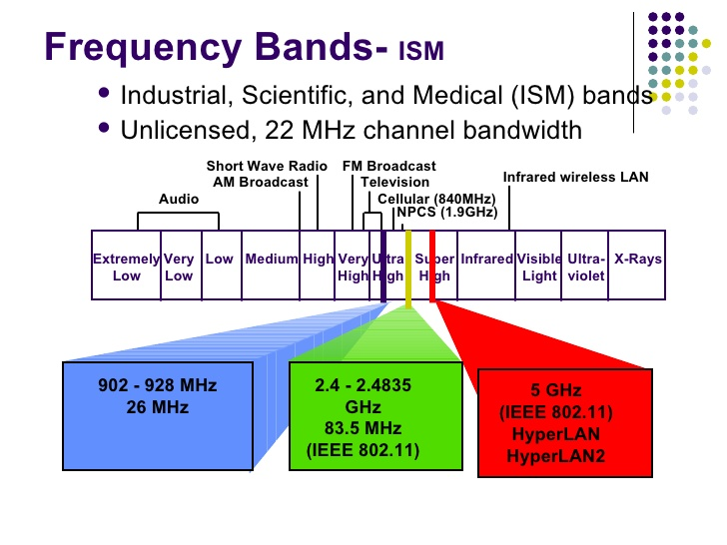
ISM Wireless Standards(3 Unlicensed Bands)
Solutions(Interference Problems)
Law Enforcement for ISM machines
For 13MHz and 27 MHz machines that exceeds the limit and results in interference with ATC or any private business radio bands and to domestic TV reception must be enforced by Law enforcement agencies for regulation according to ISM standards.
Continuous Monitoring by RF Engineers
The one excellent solution with better outcomes instead of enforcement is to completely get in touch on regular basis with RF engineering experts which may keep record and inspect on weekly basis about the performance of ISM machines according to ISM standards.

Slide 29
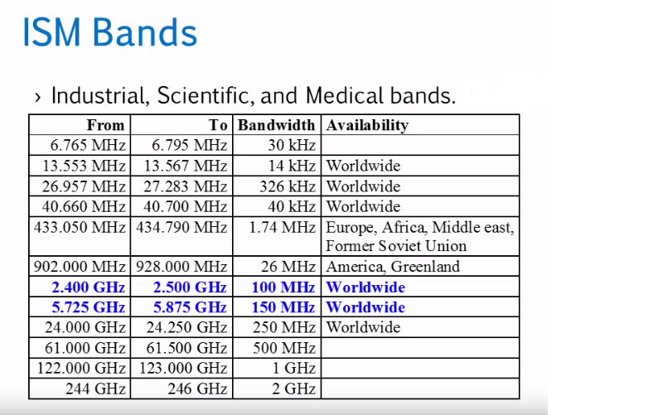

Slide 30
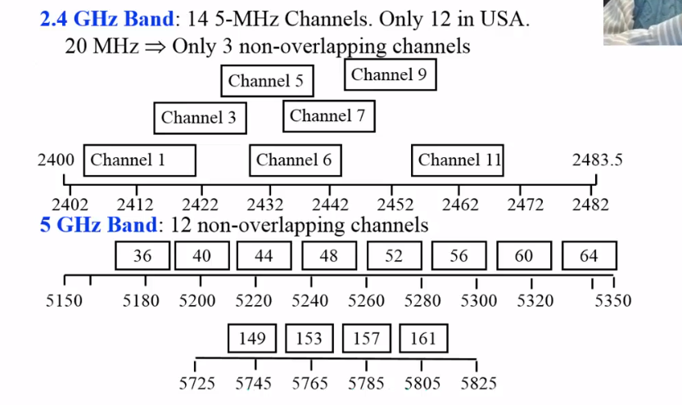

Slide 31
REFERENCES
[1] IEEE Standard for Information technology - Telecommunications and information exchange between systems - Local and metropolitan area networks - Specific requirements - Part 11: Wireless LAN Medium Access Control (MAC) and Physical Layer (PHY) Specifications Amendment 5: Television White Spaces (TVWS) Operation," in IEEE Std 802.11af-2013 (Amendment to IEEE Std 802.11-2012, as amended by IEEE Std 802.11ae-2012, IEEE Std 802.11aa-2012, IEEE Std 802.11ad-2012, and IEEE Std 802.11ac-2013) , vol., no., pp.1-198, 21 Feb. 2014.
[2] IEEE Standard for Information Technology--Telecommunications and information exchange between systems--Local and metropolitan area networks--Specific requirements Part 11: Wireless LAN Medium Access Control (MAC) and Physical Layer (PHY) specifications Amendment 10: Mesh Networking," in IEEE Std 802.11s-2011 (Amendment to IEEE Std 802.11-2007 as amended by IEEE 802.11k-2008, IEEE 802.11r-2008, IEEE 802.11y-2008, IEEE 802.11w-2009, IEEE 802.11n-2009, IEEE 802.11p-2010, IEEE 802.11z-2010, IEEE 802.11v-2011, and IEEE 802.11u-2011) , vol., no., pp.1-372, 10 Sept. 2011.
[3] American National Standard for Limits and Methods of Measurement of Radio Disturbance Characteristics of Industrial, Scientific, and Medical (ISM) Radio-Frequency Equipment," in ANSI C63.011-2000 , vol., no., pp.1-92, 18 Nov. 2000.
[4] K. Natarajan, D. Gangopadhyay and D. Aiistot, "A PLL-based BFSK transmitter with reconfigurable and PVT-tolerant class-C PA for medradio & ISM (433MHz) standards," 2013 IEEE Radio Frequency Integrated Circuits Symposium (RFIC), Seattle, WA, 2013, pp. 67-70.

Slide 32
Thank you
Any questions

